Slide 1
Précis:
Design-Time Precision Analysis
Mark L. Chang
ACME Labs
4 February, 2002
ACME LAB

Slide 2
Motivation
Mapping algorithms to FPGAs can be tough
Coping with precision is a key difficulty in mapping to hardware
  Too many bits == wasted resources
  Too few bits == incorrect results
Difficult for the non-hardware-savvy
Need tool to help designer optimize bit-widths
Still want to develop in a high-level description language
  MATLAB, C, C++, Java

Slide 3
Motivation
Few tools can automate HDL generation
  C-to-Verilog, C-to-VHDL
  MATCH (MATLAB to target code for embedded systems)
  Proprietary systems and languages…
Even fewer tools offer “Designer Aides”
  Floating-point to fixed-point translation
  Flexible resource utilization (e.g. memory vs. logic)
  Dealing with precision issues
Tool gap in design-time tools

Slide 4
Typical Tool Chain
Algorithm
Simulator
translation
HDL
Description
Compiler
+
Synthesizer
Place
&
Route
Bitstream

Slide 5
Role of Précis in Tool Chain
Algorithm
Précis
Simulator
translation
HDL
Description
Compiler
+
Synthesizer
Place
&
Route
Bitstream

Slide 6
Compiler Front-End
MATCH compiler from Northwestern University
  Understands a subset of the MATLAB grammar
  Utilizes annotations to provide hints to the compiler
  Constructs an Abstract Syntax Tree based on the MATLAB source
  Coded in C++ and is currently the product of a startup company, AccelChip
for p=1:rows*cols
% load pixel to process
pixel = data( (p-1)*bands+1:p*bands );
class_total = zeros(classes,1);
class_sum = zeros(classes,1);
% class loop
for c=1:classes
class_total(c) = 0;
class_sum(c) = 0;
% weight loop
for w=1:bands:pattern_size(c)*bands-bands
weight = class(c,w:w+bands-1);
class_sum(c) = exp( -(k2(c)*sum( (pixel-weight').^2 ))) + class_sum(c);
end
class_total(c) = class_sum(c) * k1(c);
end
results(p) = find( class_total == max( class_total ) )-1;
end
*
MATCH
Compiler
+
-
3
4
5
6
MATLAB source
AST

Slide 7
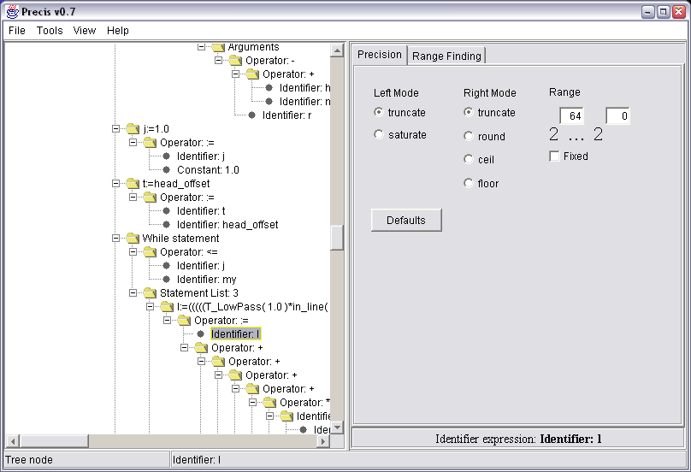
Précis Application

Slide 8
Propagation Engine
15..0
A
x = a + b
y = c + x
16..0
+
x
15..0
B
*
y
15..0
C
32..0
Constrain inputs to range of 15..0 [2^15..2^0]
Forward propagate
“x” is set to 16..0
“y” is set to 32..0

Slide 9
Propagation Engine
10..0
A
x = a + b
y = c + x
10..0
+
x
10..0
B
*
y
10..0
C
10..0
Reconsider and constrain output “y” to 10..0
Reverse propagate
“x” is set to 10..0
“a”, “b”, and “c” all set to 10..0

Slide 10
Simulation
Generates annotated MATLAB
User may specify precision constraints on any variable
Simulation demonstrates the effects of fixed-point operations which may result in rounding or truncation errors in the output
Matlab
Code
Précis
Annotated
Matlab
Matlab
Program
Output
Check for errors

Slide 11
Simulation Support
Use of a custom function to do fixed-point simulation
fixp(x,m,n,lmode,rmode)
  Constrains ‘x’ to (m-n+1) bits in width
  ‘m’ is MSB bit position, ‘n’ is LSB bit position
  ‘lmode’ specifies method to handle overflow at MSB
    ‘sat’ – saturates to 2^(m+1)-1
    ‘trunc’ – truncates all bits above position ‘m’
  ‘rmode’ specifies method to handle overflow at LSB
    ‘round’ – rounds to nearest integer level
    ‘trunc’ – truncates all bits below position ‘n’
    ‘ceil’ – rounds up to next higher integer level
    ‘floor’ – rounds down to next lower integer level

Slide 12
Simulation Example
MATLAB Input
Constrain to [2¹²..2³]
and utilize truncation on
both MSB and LSB.
a = 1;
b = 2;
c = 3;
d = (a+(b*c));
Annotated MATLAB Output
a=1;
b=2;
c=3;
d=(fixp(a,12,3,’trunc','trunc')+
(b*c));

Slide 13
Range Finding
Generates annotated MATLAB
Records ranges of variables for sample data sets
Results are reintegrated into Précis to allow for more investigation
Matlab
Code
Précis
Annotated
Matlab
Matlab
Program
Output
Variable
Stats

Slide 14
Range Finding Example
MATLAB Input
Range Finding Output
a = 1;
b = 2;
c = 3;
d = (a+(b*c));
a=1;
b=2;
c=3;
d=(a+(b*c));
rangeFind(d,'rfv_d');

Slide 15
User Guidance
Want to guide a developer’s manual optimization
  Helpful for a novice designer
  Provides a starting point for hand-optimization
  Allows iterative optimization of the implementation
    Optimize until if fits and runs…
    Optimize further if we have time/money
“Call and Response” methodology ☺
  We ask questions, developer answers
    What is the algorithm
    Known precision of variables
    Simulation and data gathering
Provide suggestions to the user

Slide 16
Slack Analysis
Try to identify nodes that have the greatest area impact on the final circuit implementation
Present these results as an ordered list of “moves” for the user to (optionally) make
Propagation == upper bound
Range finding == lower bound
Difference == Slack

Slide 17
Slack Analysis
For each node with slack, set precision to lower bound
  Propagate change through system
  Calculate the gain in area for this “move”
This creates a “tuning list” of variables to consider
Iteratively, the user can choose to make moves and recalculate what the next move should be

Slide 18
Slack Analysis
Algorithm: Slack Analysis
User Step #1: Constrain known variables
User Step #2: Perform propagation
User Step #3: Load range data for some set of variables ‘n’
set list_of_gains to empty list
for each variable ‘m’ in ‘n’
set aggregate_gain = 0;
constrain range of ‘m’ to the range analysis value;
perform forward and reverse propagation;
aggregate_gain += total area;
add (variable ‘m’ and aggregate_gain) to list_of_gains;
reset all variables to propagated values;
next
sort(list_of_gains) by decreasing aggregate_gain;

Slide 19
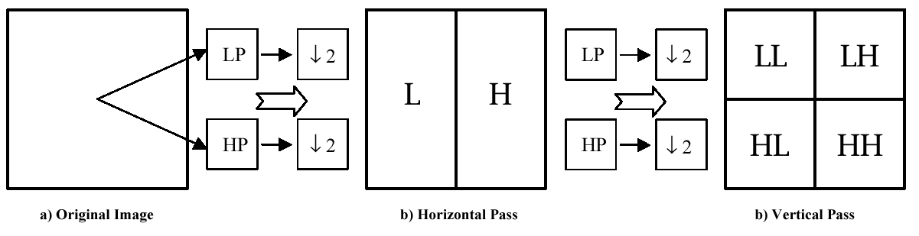
Benchmark: Wavelet Transform
Perform high-pass and low-pass filtering in each dimension
Follow with down-sampling to produce two half-sized sub-band images
Repeat for as many levels as desired on LL sub-band

Slide 20
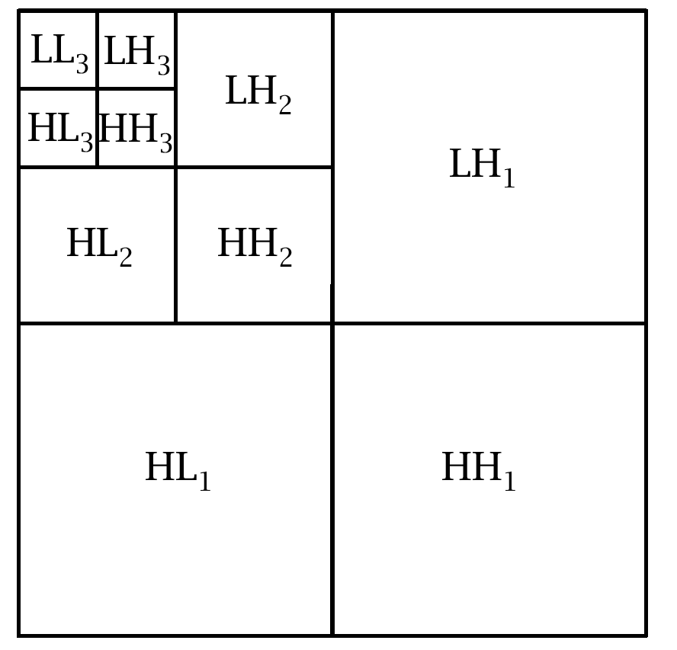
Wavelet Transform

Slide 21
Wavelet Transform Structure
D(x)
f(1)
D(x+1)
D(x-1)
f(2)
Low Pass
+
+
x
D(x+2)
D(x-2)
f(3)
+
+
x
D(x+3)
D(x-3)
f(4)
+
+
x
D(x+4)
D(x-4)
f(5)
+
+
x
+
outputImage

Slide 22
Wavelet Transform Structure
D(x)
f(1)
D(x+1)
D(x-1)
f(2)
High Pass
+
+
x
D(x+2)
D(x-2)
f(3)
+
+
x
D(x+3)
D(x-3)
f(4)
+
+
x
+
outputImage

Slide 23
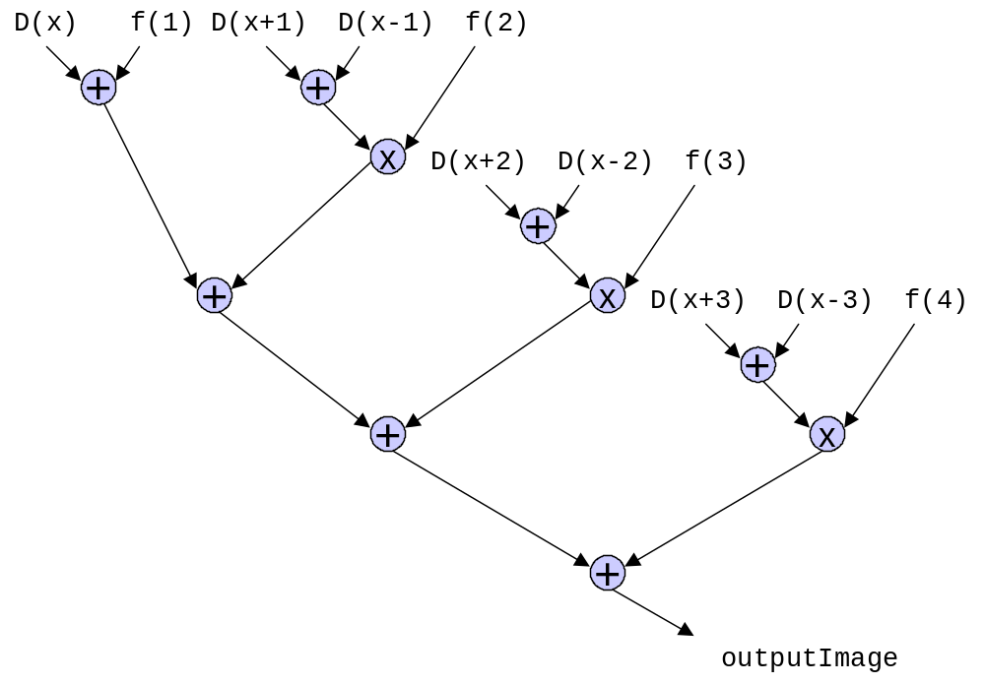
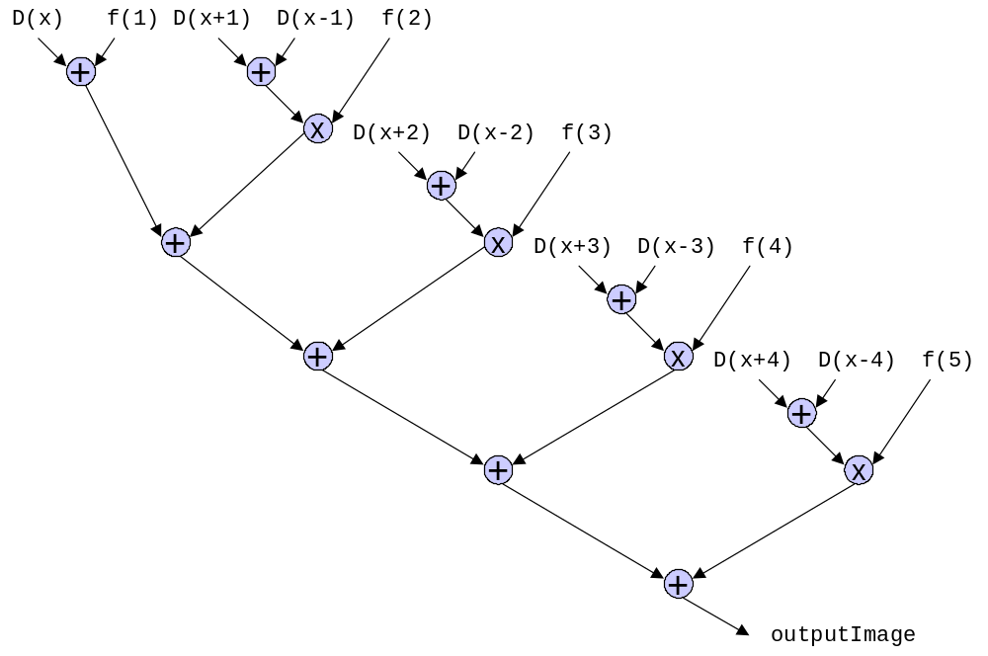
Wavelet Transform
High Pass
1
Low Pass

Slide 24
Wavelet Transform
High Pass
2
Low Pass

Slide 25
Wavelet Transform
High Pass
3
Low Pass

Slide 26
Wavelet Transform
High Pass
4
Low Pass

Slide 27
Wavelet Transform
High Pass
5
Low Pass

Slide 28
Wavelet Transform
High Pass
6
Low Pass

Slide 29
Wavelet Transform
High Pass
7
Low Pass

Slide 30
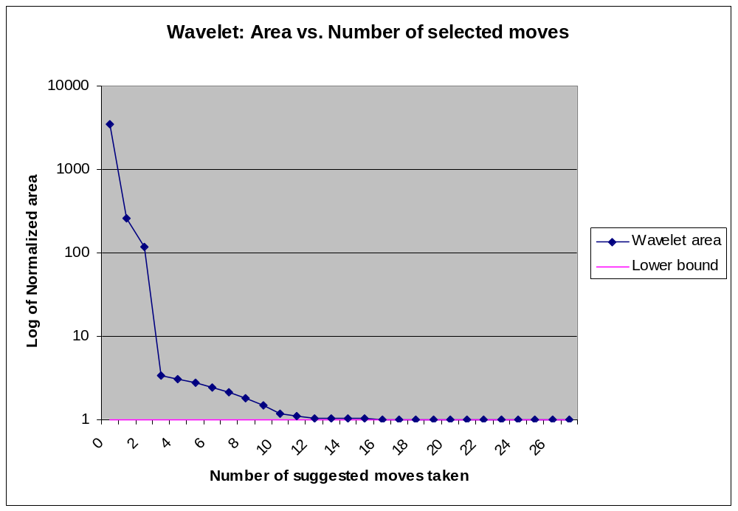
Wavelet Transform
27 variables selected for slack analysis
3 moves to within a factor of 3 of lower bound
11 moves to within 10% of lower bound
13 moves to within 3% of lower bound

Slide 31
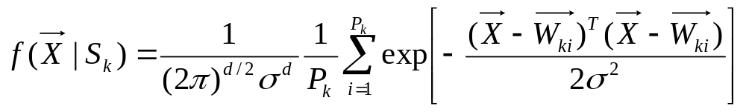
Benchmark: PNN
Pixel
Vector
Weight
Vector
Number of classes = K
10 bits
X₀
W₀
. . . . . .
d = number
of bands
d = number
of bands
Probabalistic
Neural Network
(PNN) Calculation
Class S₀
Class S_{k}
Number of weights
in class S₀ = P₀
Number of weights
in class S_{k} = P_{k}
4 bits
Classified Image

Slide 32
PNN: Structure
pixel
weight
-
x
sum
k2
k1
x
exp
x
res

Slide 33
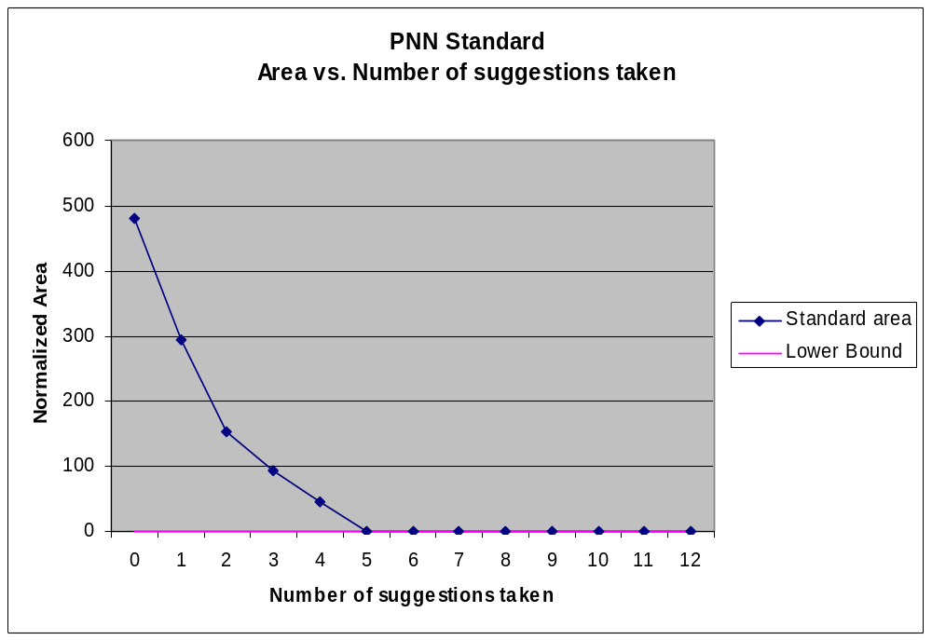
PNN: Moves suggested
9
10
pixel
weight
1
-
7
x
2
5
4
k2
k1
sum
6
3
x
exp
x
res
8

Slide 34
PNN: Experience Counts
Ranges discovered by range finding phase may be too “wide”
  Values that are very small and near zero require many bits of precision to the right of the decimal point
  Automated range-finding phase cannot determine at what point values become too small to be significant
User can re-constrain variables to more sensible values
  During slack analysis
  Before slack analysis
  User can utilize simulation to determine how much error is tolerable

Slide 35
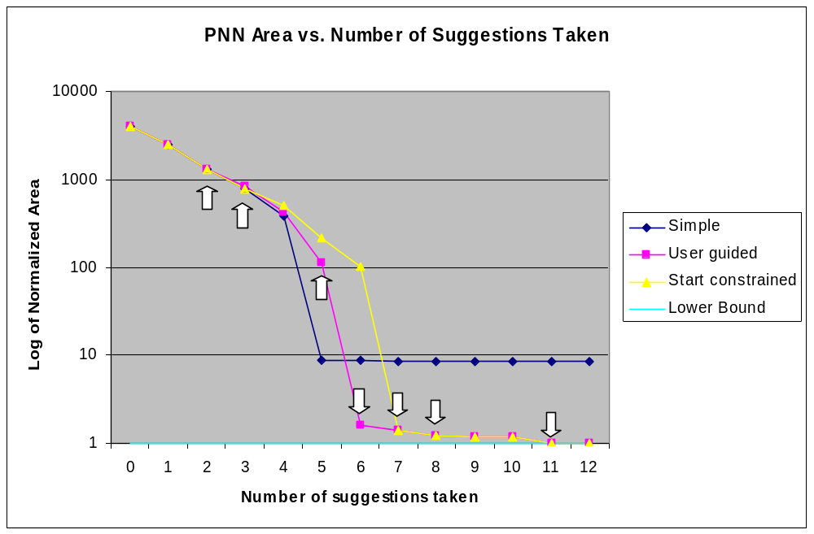
PNN: Re-Constrained Results
Guided methods reach a lower theoretical bound
Arrows denote where changes in suggestion occurred for user guided method

